Slide 1



















SDN Evolution and ONF
Non-profit, carrier and
vendor neutral
Provide technical shepherding,
core team
Build community
Many organizations supports
And Beyond
2017 – ON.Lab and ONF merger
Demonstrations
Platform
Development
Deployments
2012 –Define SDN research agenda
for the coming
years
Invention
2008-2011 – SIGCOMM
2011 – Open Networking Summit, Interop
2009 – Stanford
2010 – GENI started
and grew to 20
universities
2013 – 20 more campuses to be added
2007 – Ethane
2008 – OpenFlow
2009 – FlowVisor, Mininet, NOX
2010 – Beacon
2007 – Creation of SDN Concept

Slide 2
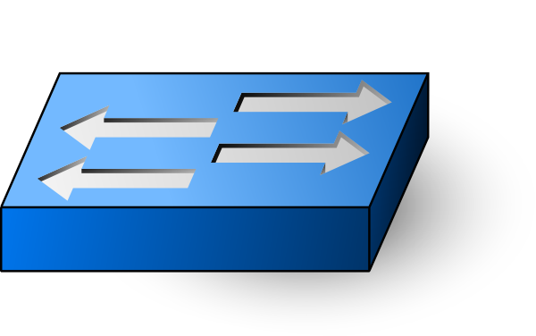
ONOS Architecture (1/2)
Contains user applications
E.g., reactive forwarding, ProxyARP,
segment routing, SDN-IP, etc.
Applications
Northbound
(policy enforcement, conflict resolution)
Transfer network info to app layer
Provide management interface for
controlling lower layer component
Distributed Core
(scalability, availability, performance, persistence)
Contains many core features
Provide distributed clustering func.
for supporting HA and scalability
Southbound
(discover, observe, program, configure)
Provide an abstracted interface for
controlling the network infrastructure
Provider
Provider
. . .
OpenFlow
NetConf
. . .
Network protocol implementation
for managing network elements
E.g., OpenFlow, NetConf

Slide 3
ONOS Architecture (2/2)
Applications
Apps
NB Core API
Distributed Core
(state management, notifications, high-availability & scale-out)
SB Core API
Providers
Providers
Providers
Providers
Protocols
Protocols
Protocols
Protocols

Slide 4
ONOS Subsystems (Services)
Off-platform Apps
REST API
GUI
CLI
SONA
Proxy ARP
L2 Forwarding
SDN IP / BGP
DHCP
. . .
Application
UI Extension
Security
Device Cfg.
Discovery
Network Virt.
Tenant
. . .
Config
Storage
Region
Driver
Path
Tunnel
Intent
Statistics
Core
Cluster
Leadership
Mastership
Topology
Network Cfg.
Flow Objective
Group
Event
Messaging
Graph
Device
Link
Host
Flow Rule
Packet
OSGi / Apache Karaf
OpenFlow
NetConf
OVSDB
. . .
OSGi Framework
On-platform Applications
South Bound
Interface module
Non-networking core subsystem
On-platform Application Interfaces
Networking core subsystem
Off-platform Applications

Slide 5







ONOS Project at ONF
Mobile
Services
Enterprise
Services
Residential
Services
Mobile
Enterprise
Residential
XOS
Trellis
ONOS
VOLTHA
Stratum
ODTN
PON
OLTs
PON
OLTs
Shared Cloud Infrastructure
ROADM
(Core)

Slide 6
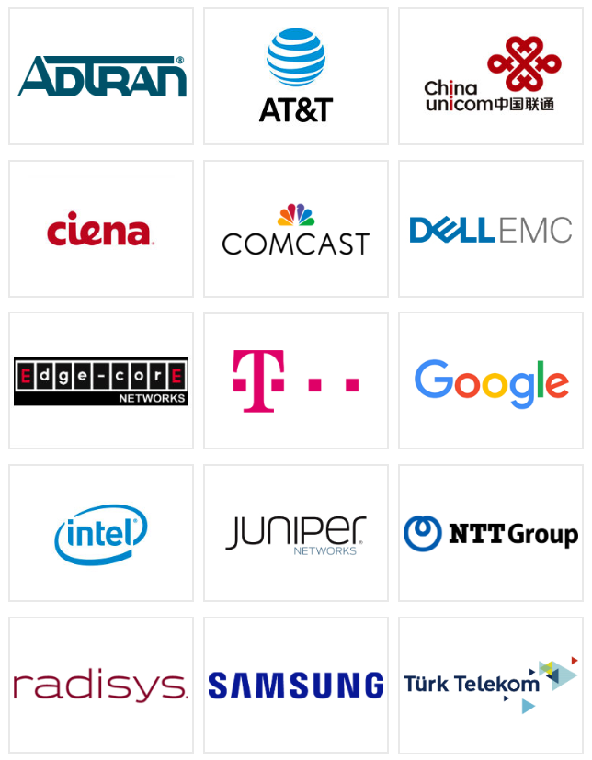
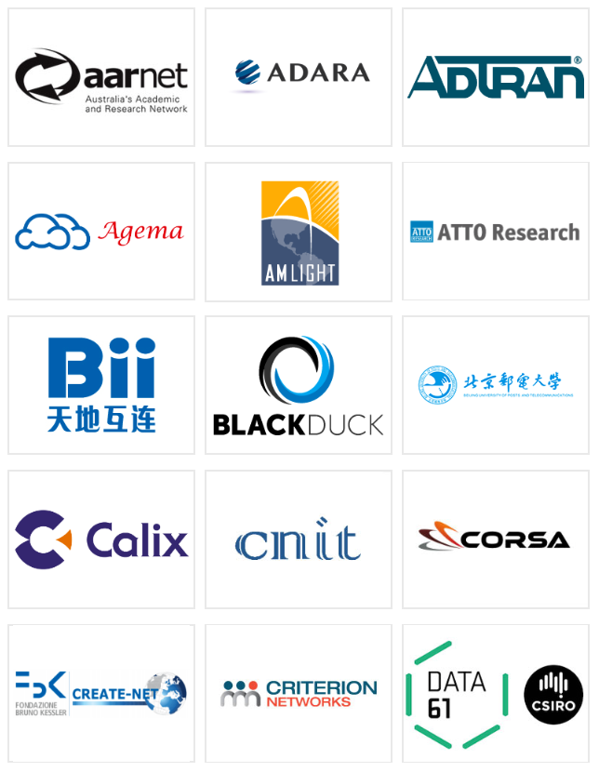
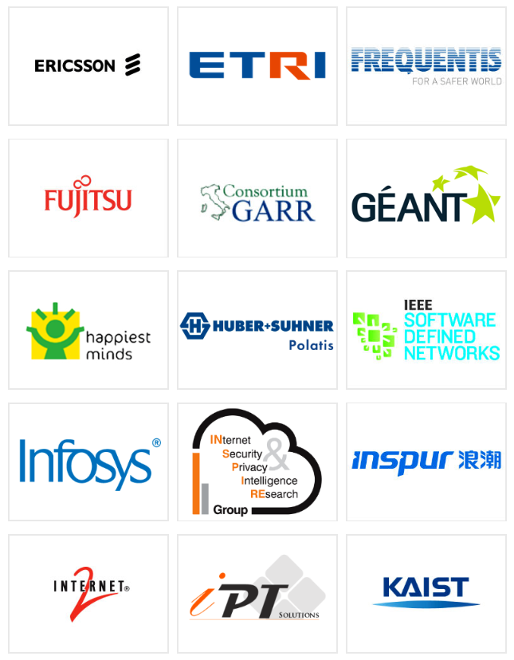
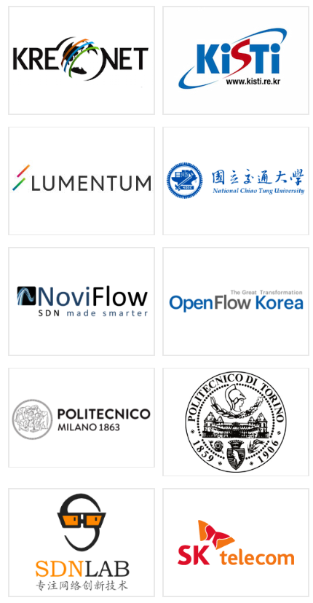

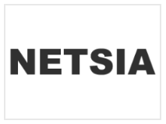




ONOS Community
Partners
Collaborators

Slide 7


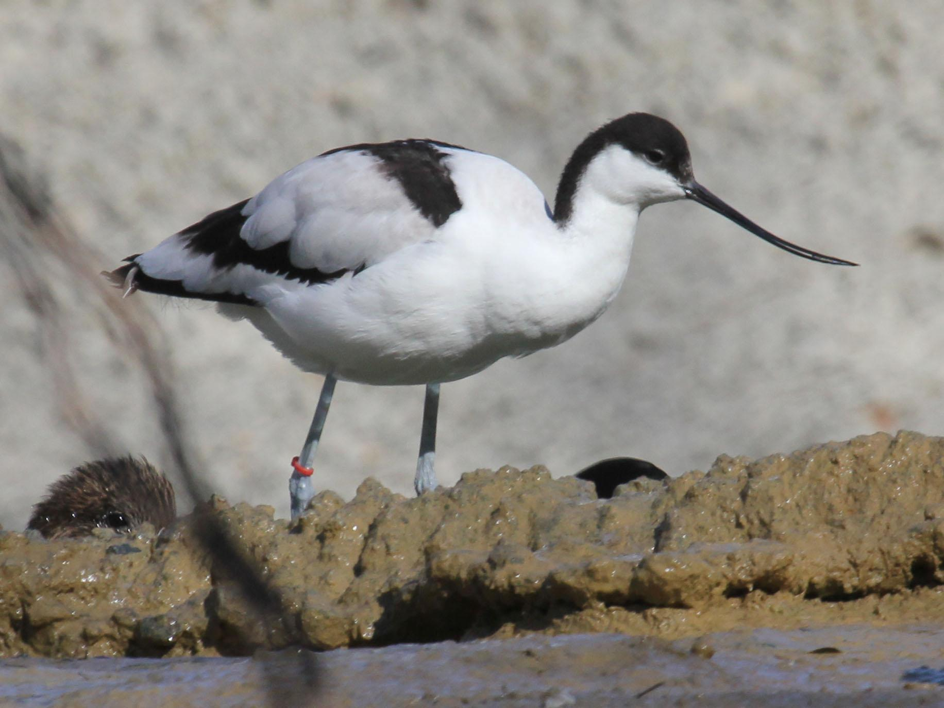


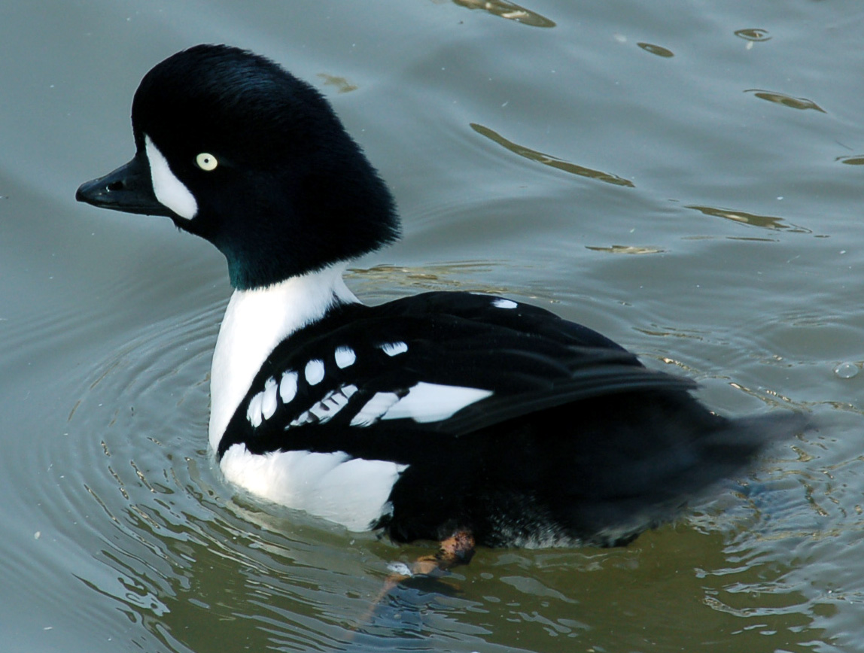




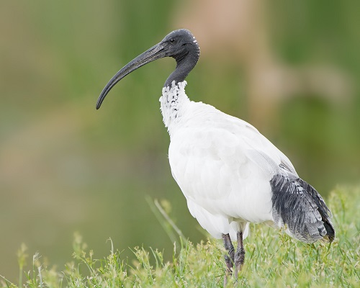

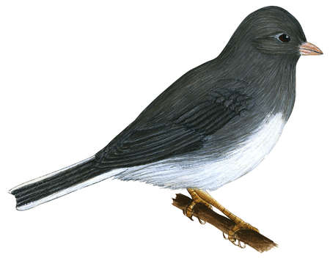
ONOS Release History
Q4/14 Avocet
Base Architecture
Q1/16 Falcon
ONS Use Cases
{A, E, M} CORD
Disaggregated ROADM
Global R&E Deployment
Q2/17 Kingfisher
YANG Tools 2.0
OpenFlow 1.4 support
Intent F/W improment
vRouter, OpenROADM support
Q1/15 Blackbird
Performance
Q2/16 Goldeneye
CPMan Apps
Intents using Flow Objectives
P4 DEMO support
YANG tool chain
Q3/17 Loon
OpenFlow 1.5 SBI
gRPC NBI support
P4 runtime initial support
Q2/15 Cardinal
ONS Use Cases
SDN-IP
Packet Optical
R-CORD
Q3/16 Hummingbird
RabbitMQ, Kafka Message
YANG NBI, SBI CODECs
ACTN Traffic Engineering
Q4/17 Magpie
Topo2 initial support
More switch driver support
Q3/15 Drake
ONF ATRIUM
Secure Mode ONOS
VxLAN
Device Configuration
Q4/16 Ibis
BUCK Build Tool
Trellis Fabric enhancement
LISP SBI support, REST Client, FatTree simulator
Q1/18 Nightingale
ISSU initial support
Trellis enhancement (T3)
P4 support enhancment
Q2/18 Owl
Coming soon…
Q4/15 Emu
OPNFV
SONA
AARNET
KREONET-S
Q1/17 Junco
TL1 SBI support
Virtualization support
Regionalization support
Dynamic conf. enhancement

Slide 8




SONA Fabric (Leaf-Spine Fabric)
SONA Fabric Manager
Configuration Automation
Traffic Engineering
Fast Failure Detection
Failure Discovery
REST
/ OF
Spine
Spine
Leaf
Leaf
Leaf

Slide 9
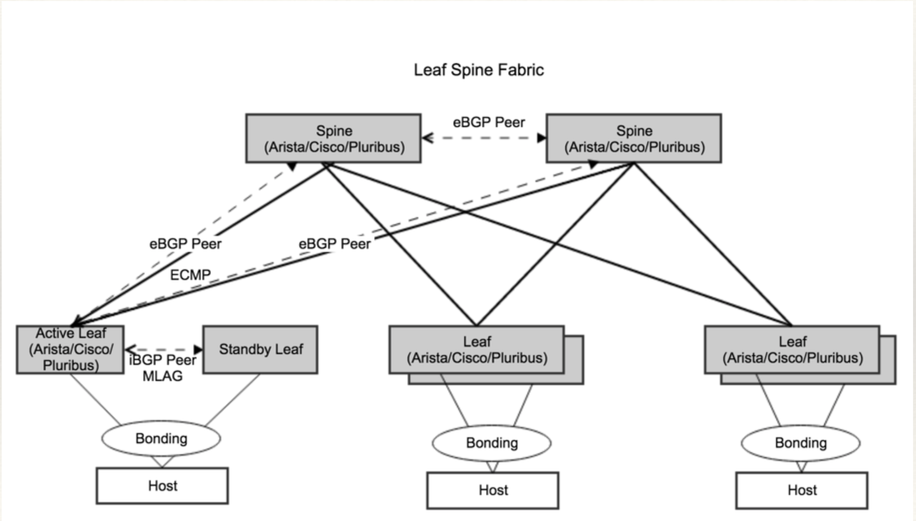
SONA Fabric - BGP

Slide 10
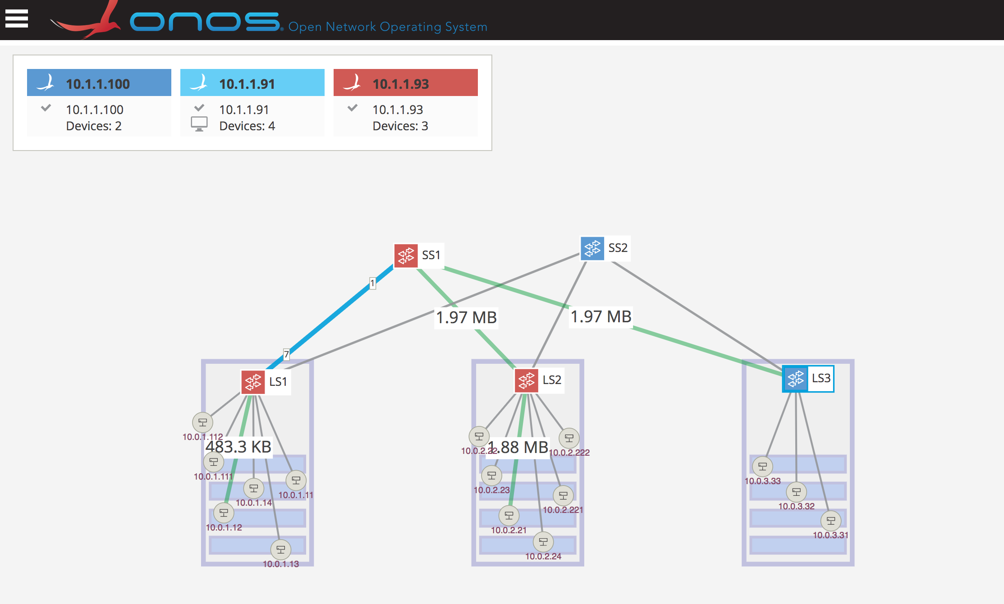
SONA Fabric - OF
Pure OpenFlow based Leaf-Spine Fabric Solution
Supports ECMP, Failure detection & auto recovery
Physical + Virtual Network Integration

Slide 11
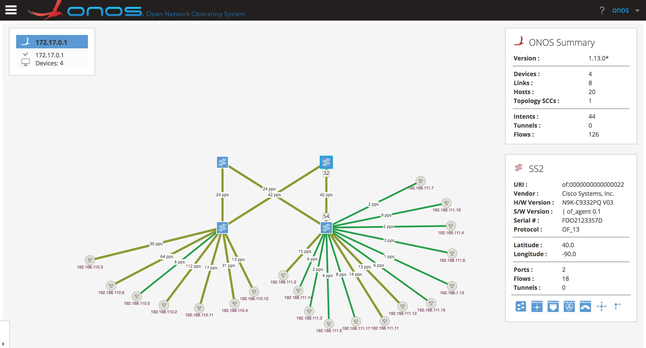
SONA Fabric - Deployment
AI Cloud Test-bed : Two Racks with 20+ servers (10G) and 4 Storages (40G)

Slide 12

SONA Fabric - Monitoring
vFlow Statistics
  Collect VM to VM real-time flow statistic
  Stats collection is realized using OpenFlow
  standards protocol (no extra overhead!)
  Seamless integration with monitoring
  systems through various NBIs
    REST, Kafka, gRPC, influxDB, etc.
  Realized through Telemetry app
  No additional software installations are
  required at OpenStack side
  No additional hardware installations are
  required at compute/control node
  Open source!
REST
Kafka
gRPC
influxDB
…
Telemetry
…
SDN Controller
OpenFlow
Host
Host

Slide 13
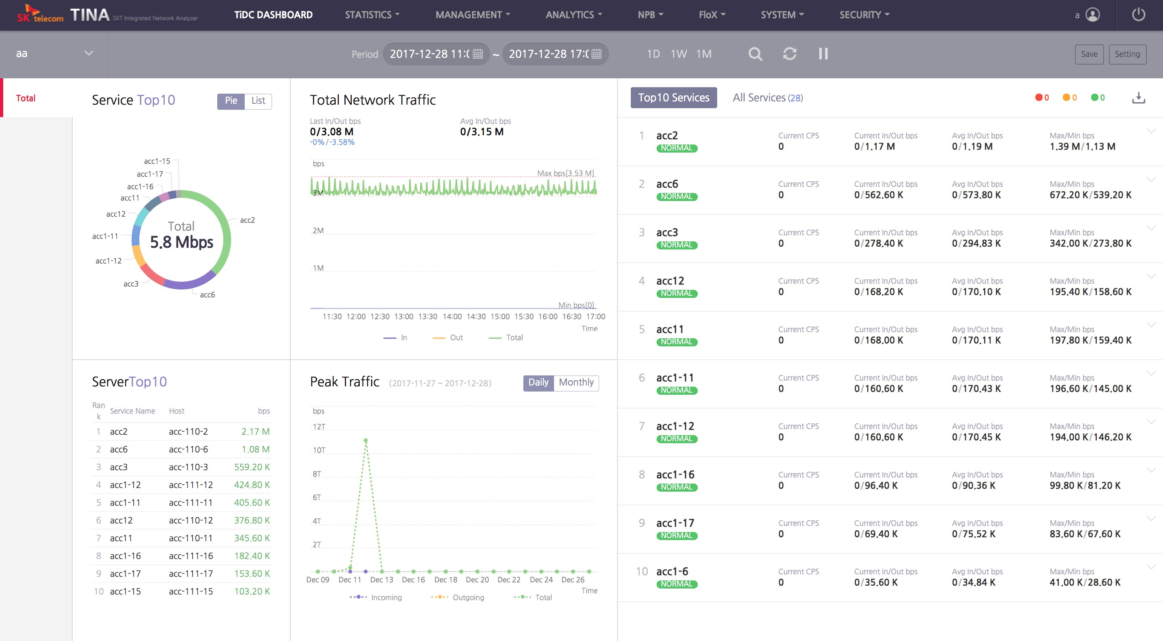
SONA Fabric - Monitoring
Traffic Monitoring with TINA

Slide 14
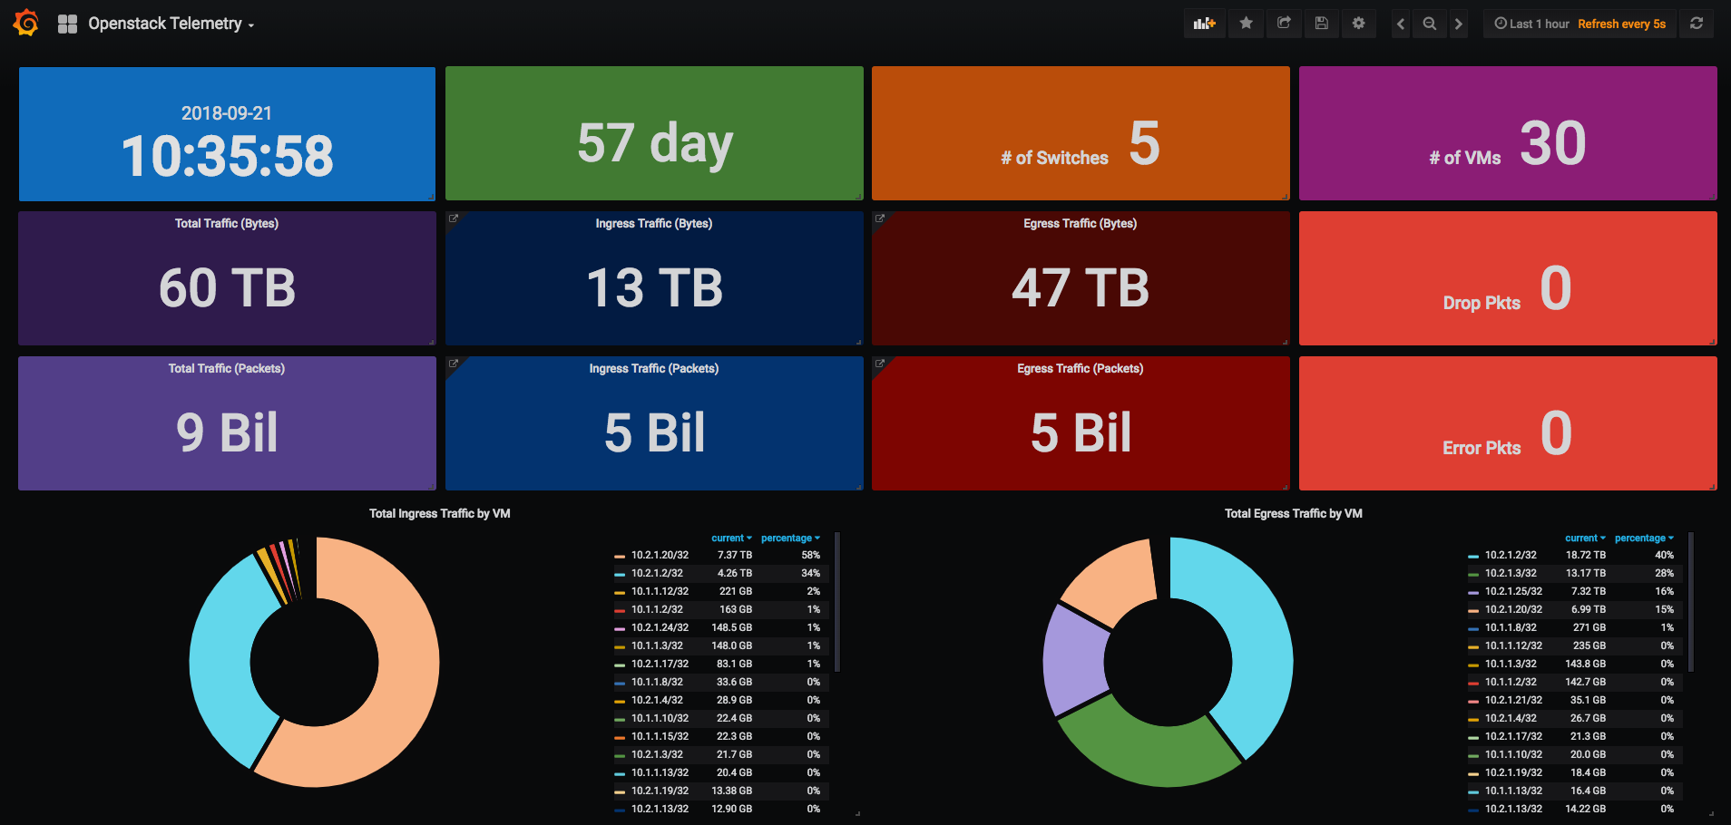
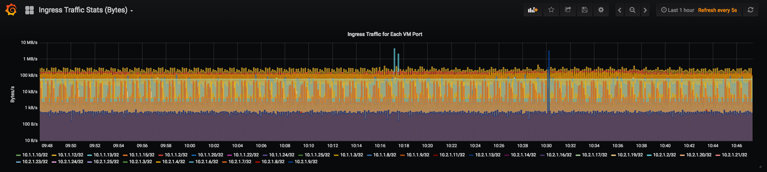
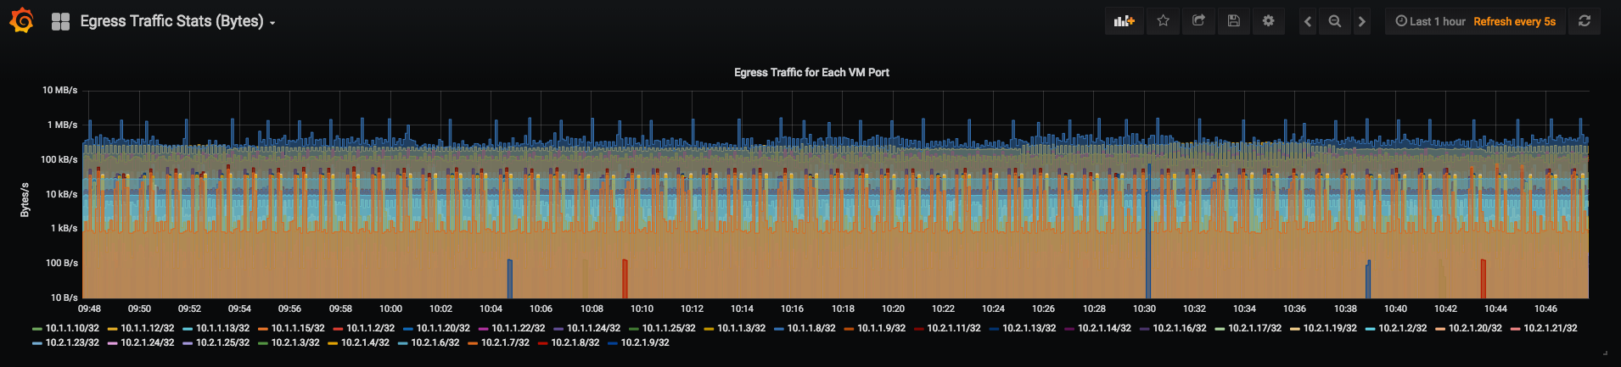
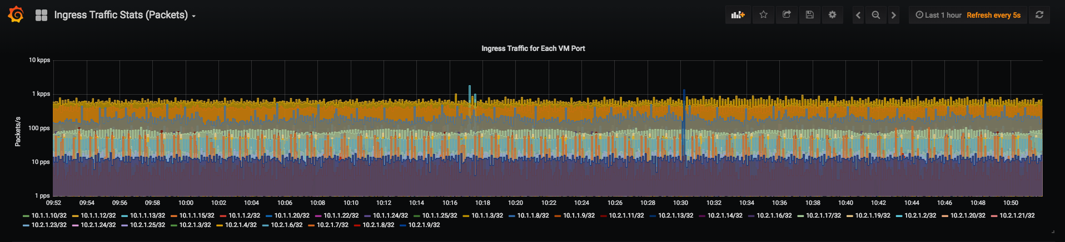
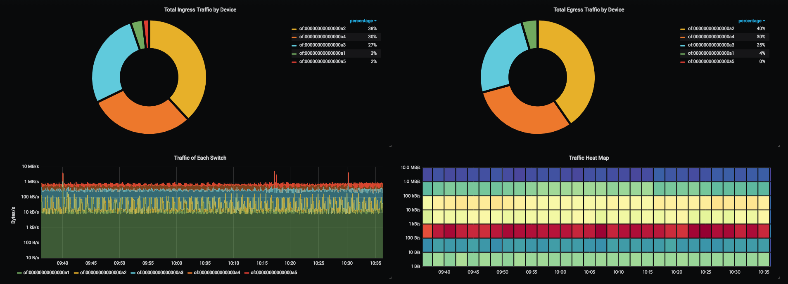
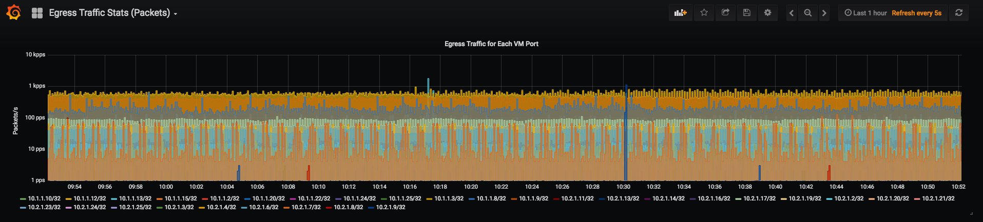
SONA Fabric - Monitoring
Grafana UI

Slide 15
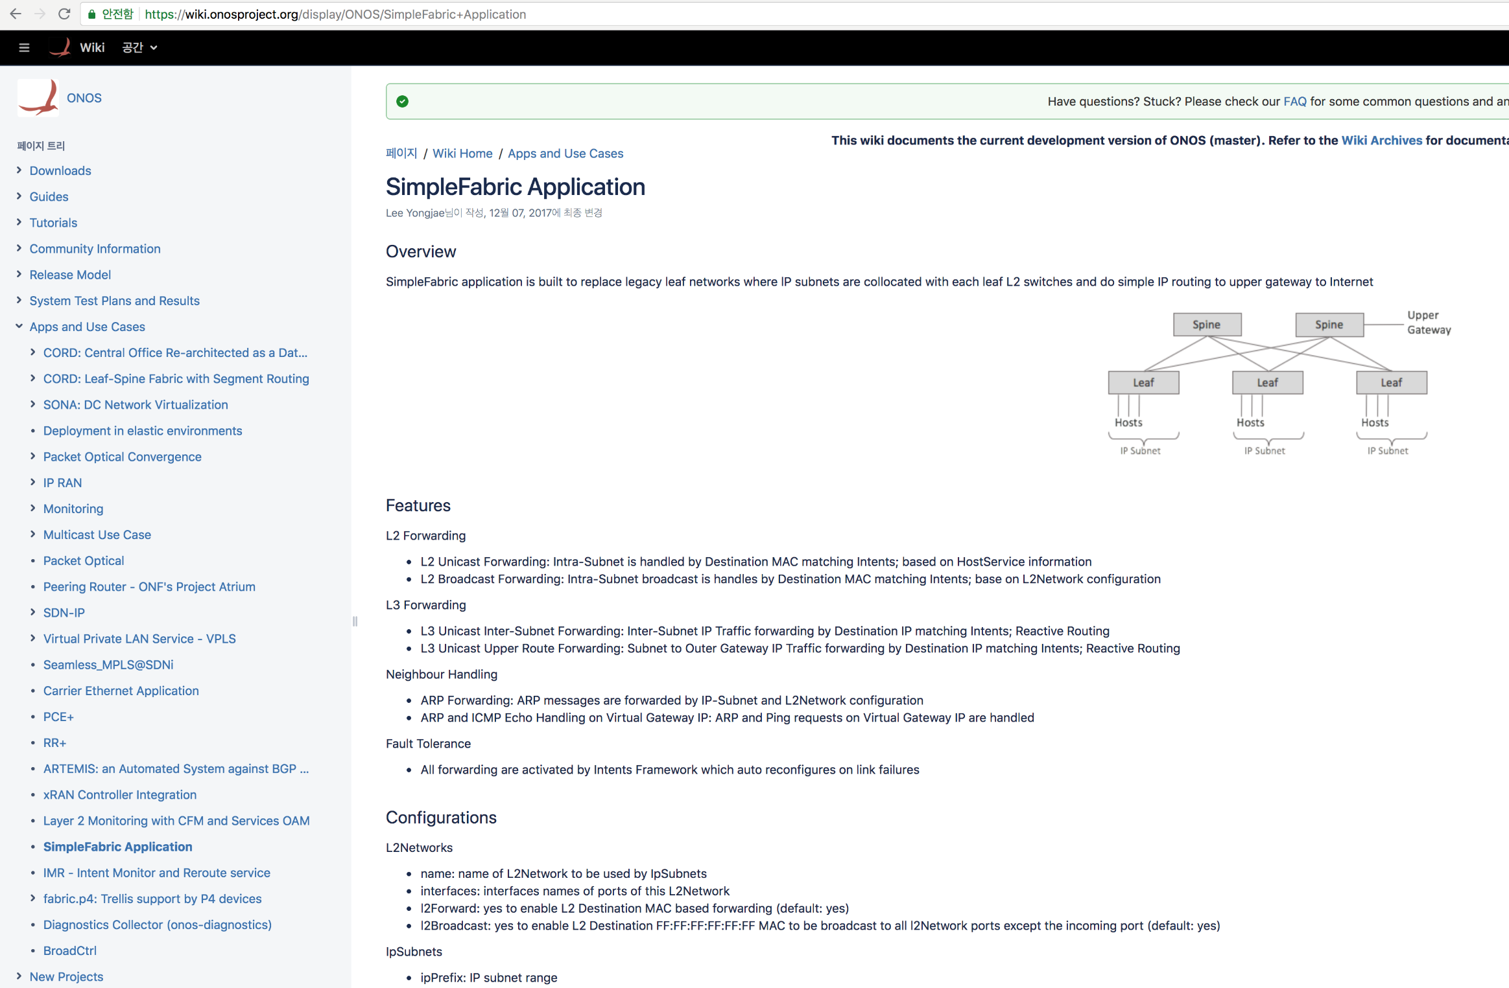
SONA Fabric – Open Source
All codes are 100% open
https://github.com/opennetworkinglab/onos
https://wiki.onosproject.org/display/ONOS/SimpleFabric+Application

Slide 16
Thank you

